Slide 1
CaO Submodel RMSEs

Slide 2
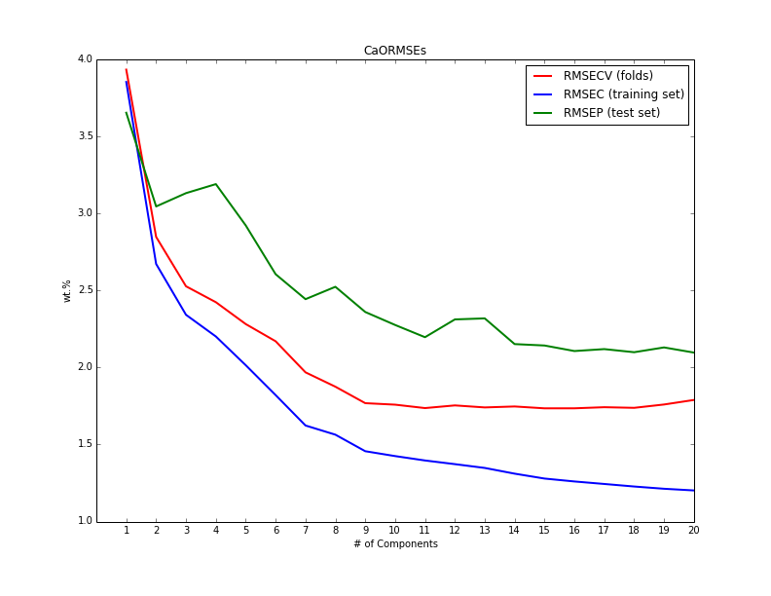
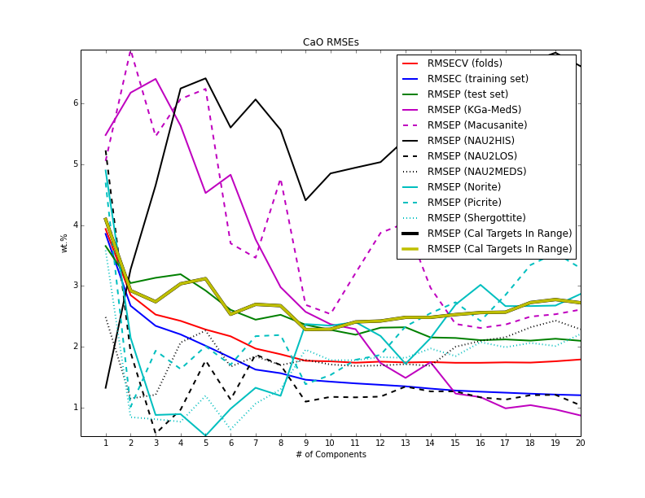
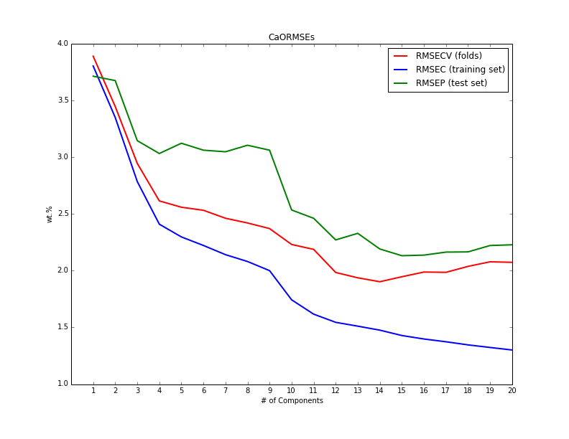
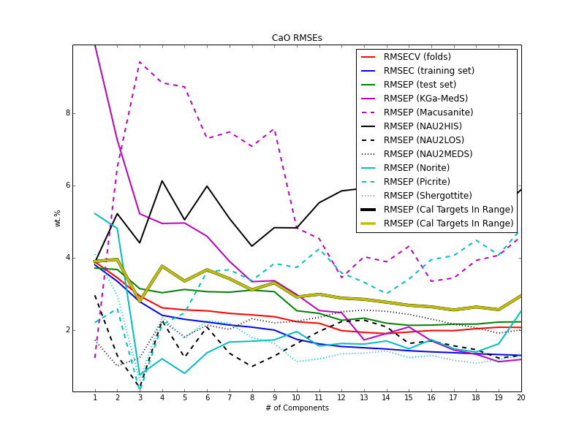
Full - Norm 3
Full - Norm 1

Slide 3
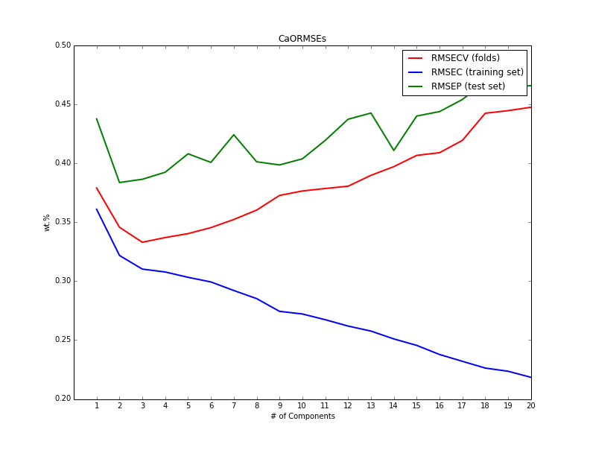
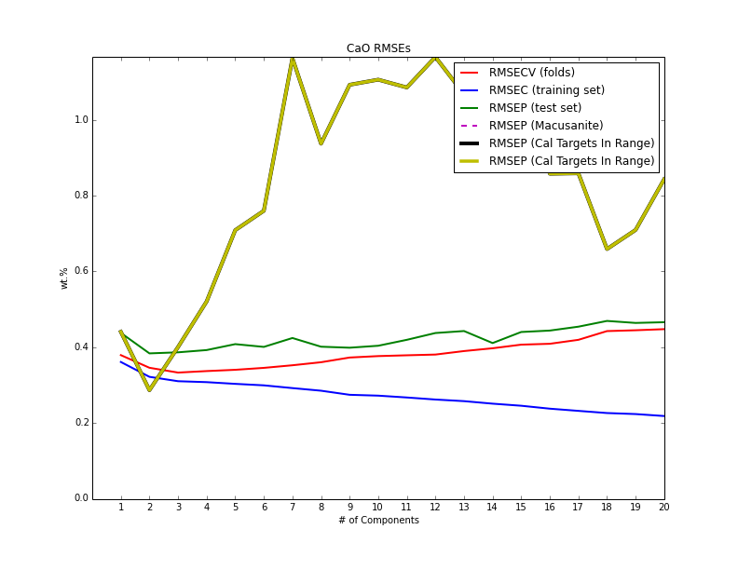
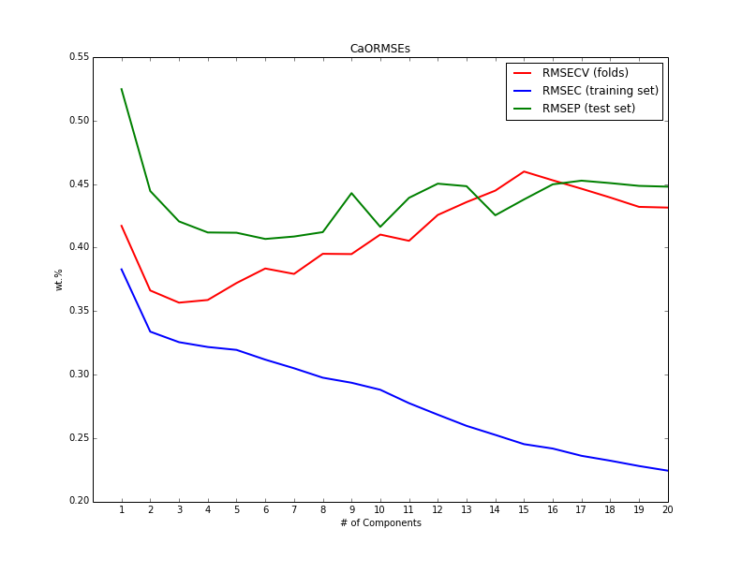
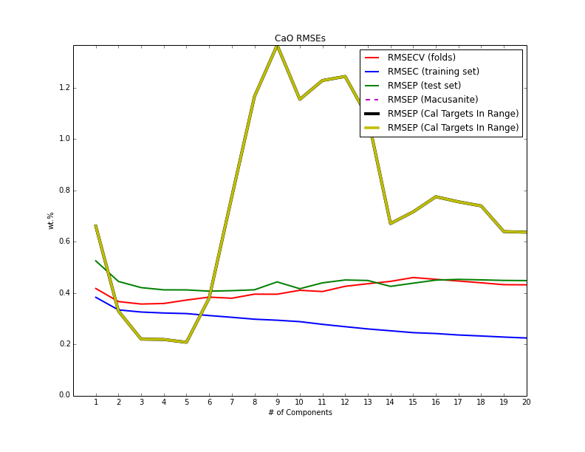
Lowest (0-2.5) - Norm 3
Lowest (0-2.5) - Norm 1

Slide 4
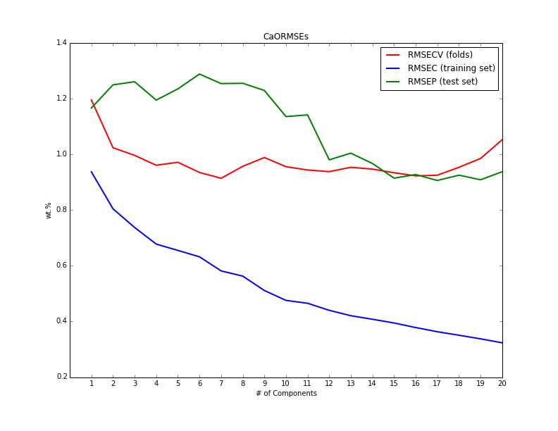
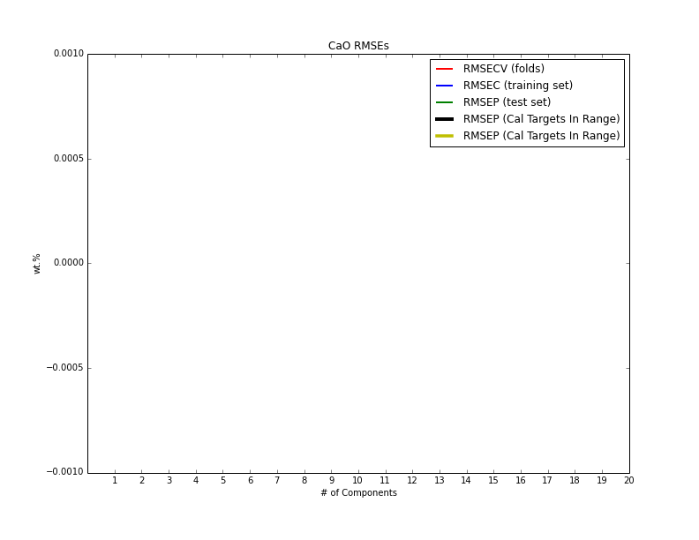
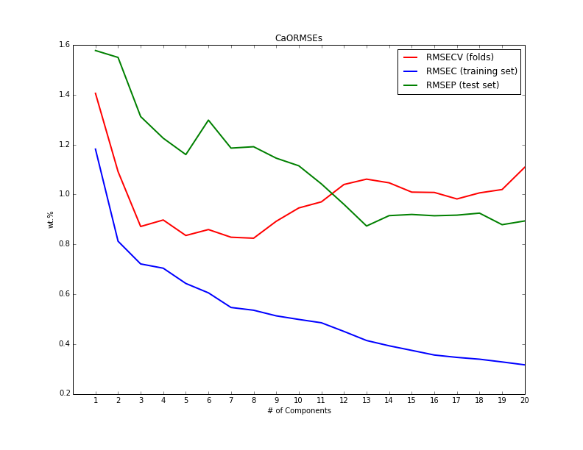
Low (2-7) - Norm 3
Low (2-7) - Norm 1

Slide 5
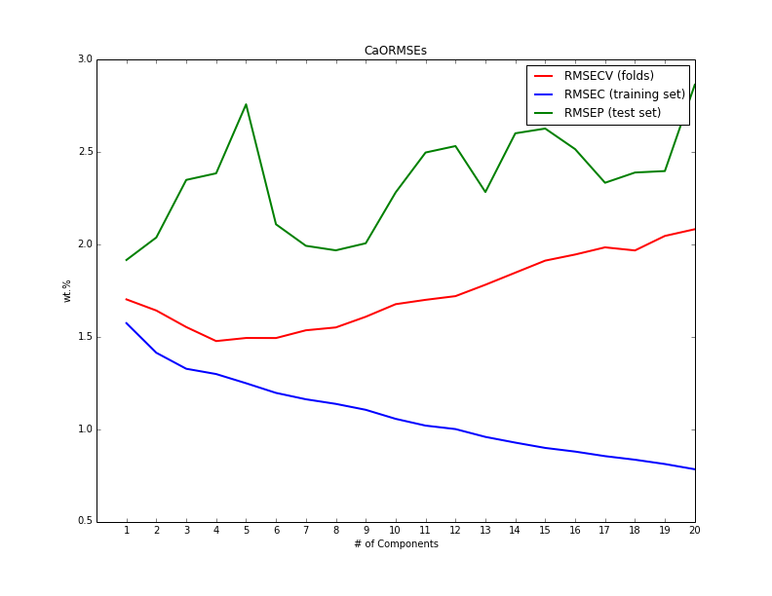
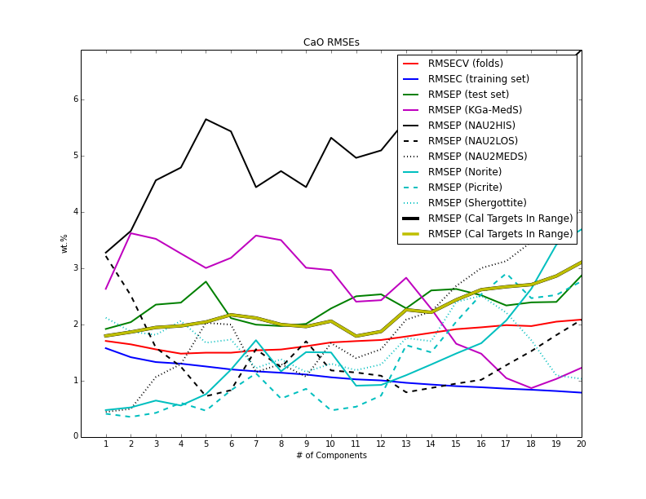
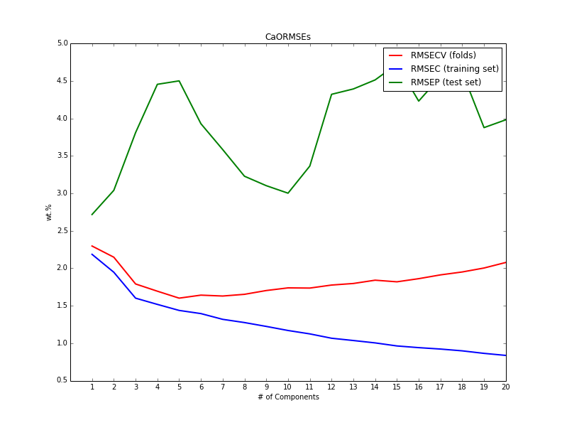
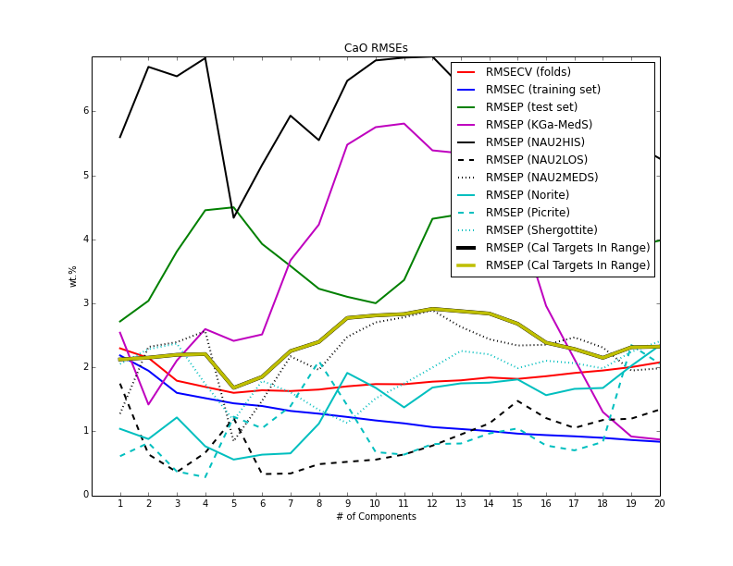
Med (6-20) - Norm 3
Med (6-20) - Norm 1

Slide 6
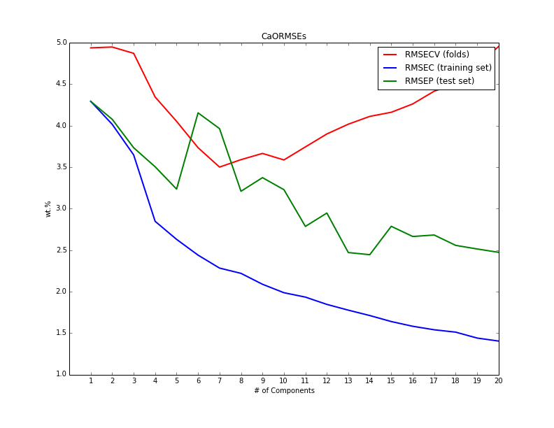
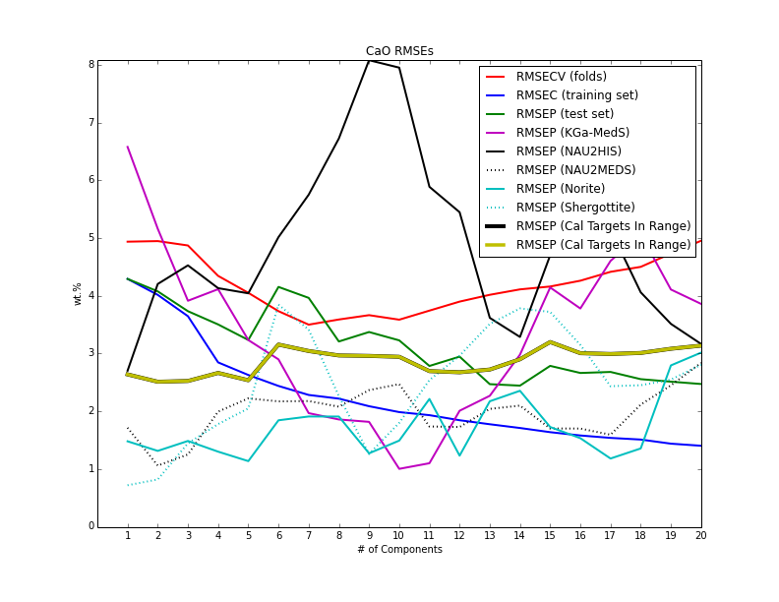
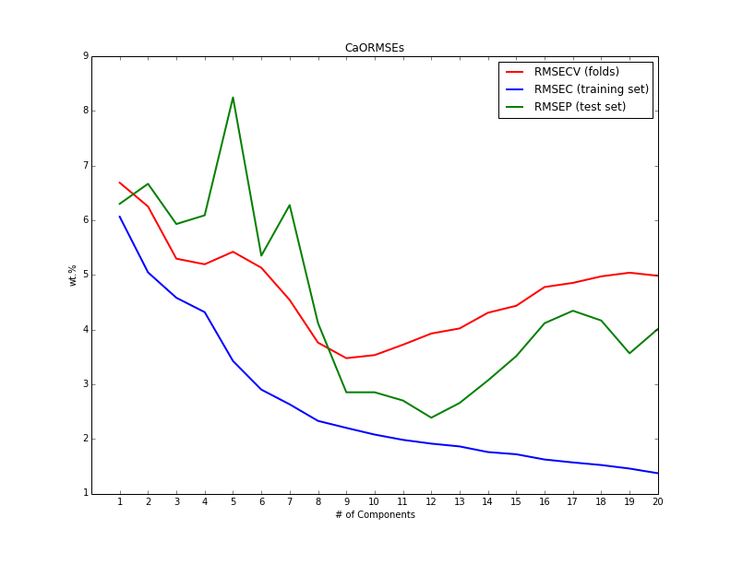
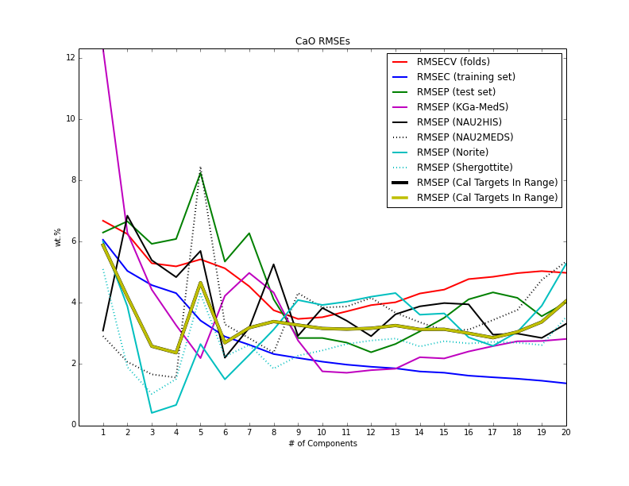
High (10-100) - Norm 3
High (10-100) - Norm 1

Slide 7
Full | Lowest (0-2.5) | Low (2-7) | Med (6-20) | High (10-100)
Norm 3 | Norm 1 | Norm 1 | Norm 1 | Norm 3
NC = 9 | NC = 3 | NC = 3 | NC = 5 | NC = 7

